Slide 1

The HUB as a cloud based service
Riccardo Soldan
March 2023

Slide 2

Content
Introduction to the HUB
What can be done and what cannot be done
All the necessary information and material used in this training is available in our GitHub repository

Slide 3
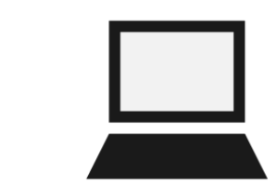

The HUB
The HUB is a cloud based environment, powered by University of Cantabria, that allow registered users to access a JupyterLab. Here, users can work with R or python, install libraries, perform computational work
GitHub
64 Gb RAM
60 cores

Slide 4
How to use the HUB
Riccardo Soldan
March 2023

Slide 5
Content
Login
Customize your environment (notebooks, folders, etc)
Open a notebook
Installing packages
Code of conduct

Slide 6
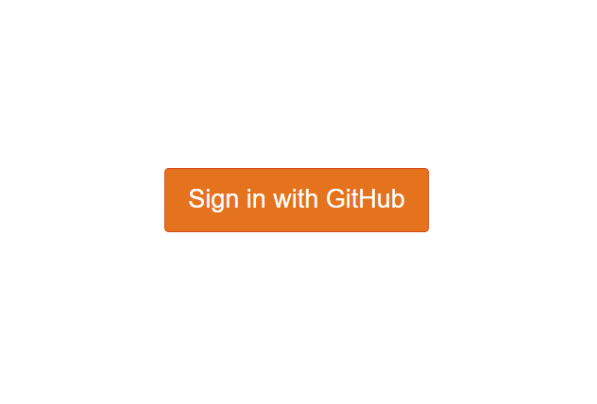
Login
Log-in to the HUB (You need to login to GitHub first). It is as simple as clicking the link
You will be able to access the HUB if you were registered among allowed users
If you are not, fear not. This workshop is useful regardless, so stay focus

Slide 7
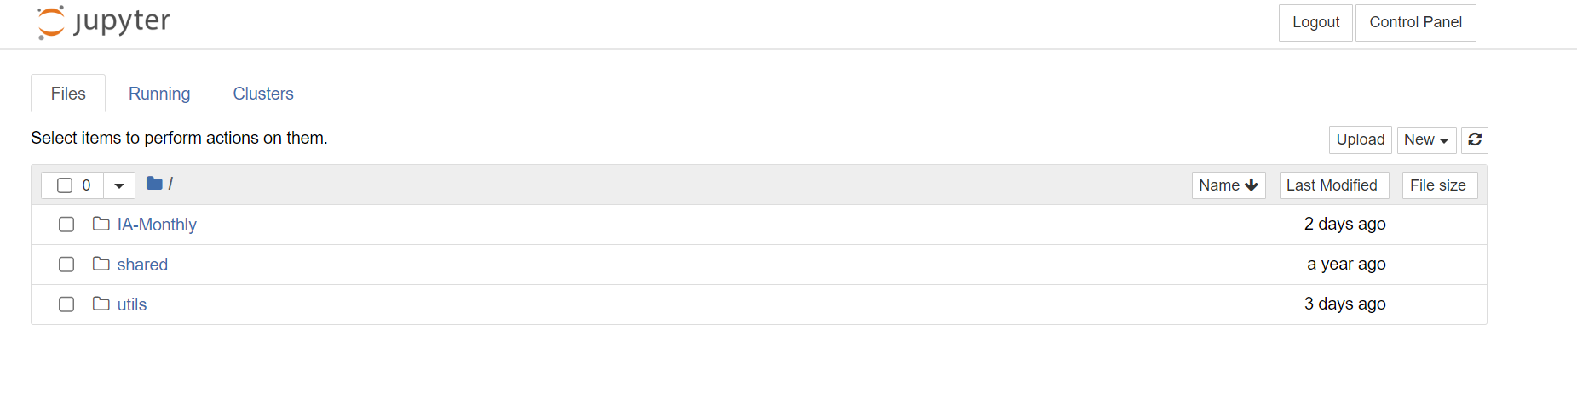
Customize your environment
Once you log in, you would see the page below. You are now using a virtual machine

Slide 8
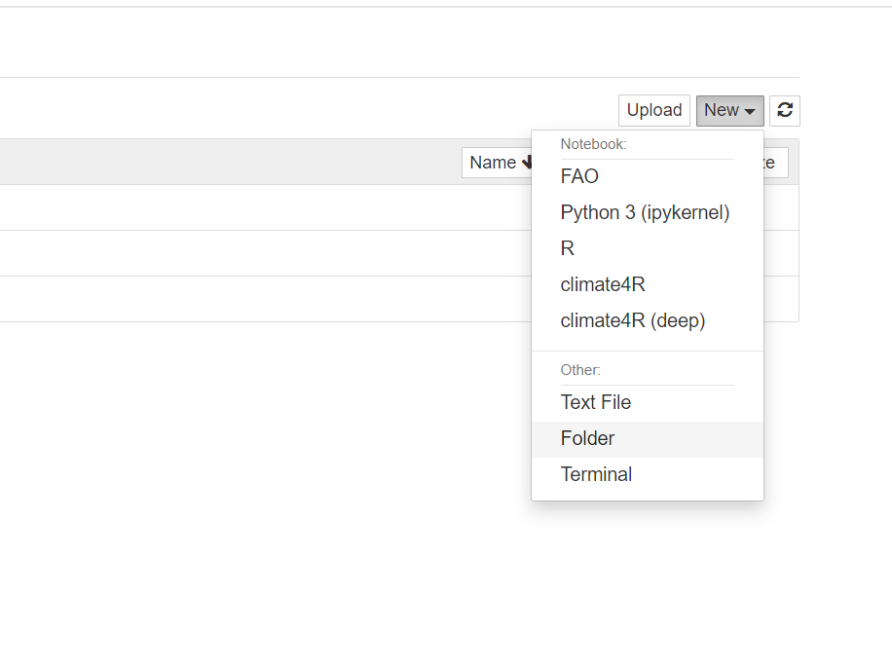
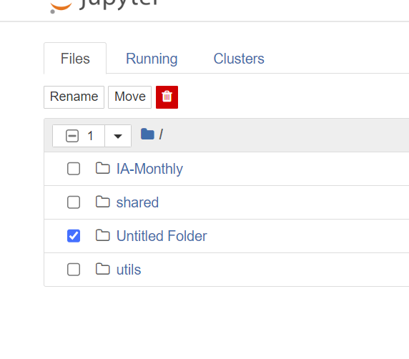
Customize your environment
You can now customize your environment (e.g create a folder with your name)

Slide 9
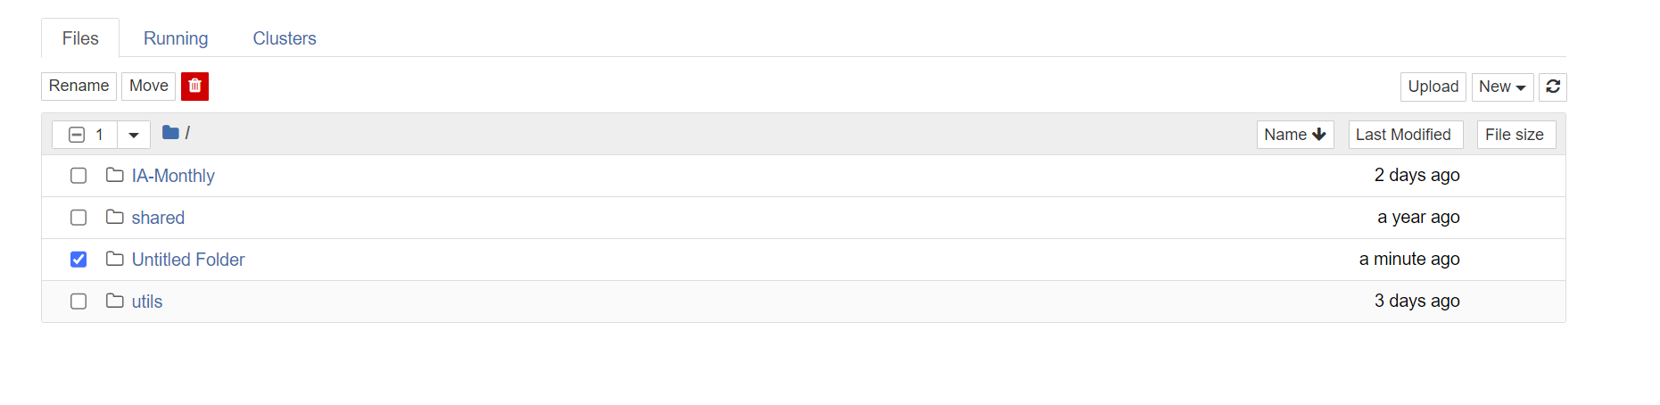
Customize your environment
You can also upload some data (e.g an excel file) (space is limited, do not upload Gbs of data)

Slide 10
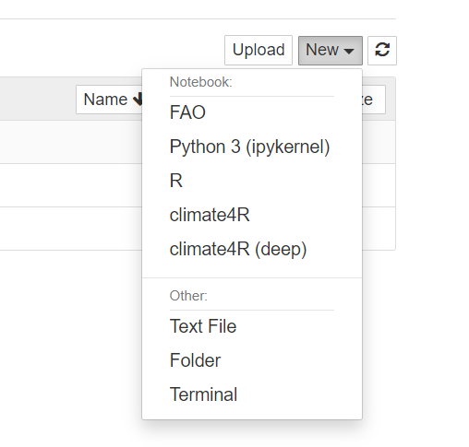
Understanding environments
You can choose the environment that you want to use. Environments are conda environments that contains R installation and a pre-set of installed packages. Read why it is useful to work with conda environments here
Create a FAO notebook to use CAVA Analytics and use most of the packages you would need
Create a climate4R notebook if you want to use with climate4R. FAO environment also contains climate4R

Slide 11
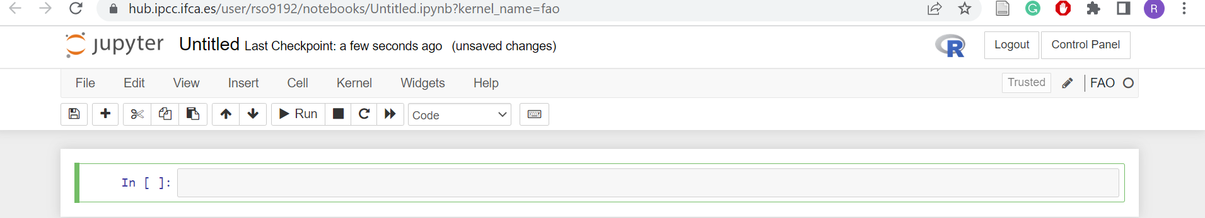
Opening a FAO notebook
Create a new FAO notebook

Slide 12
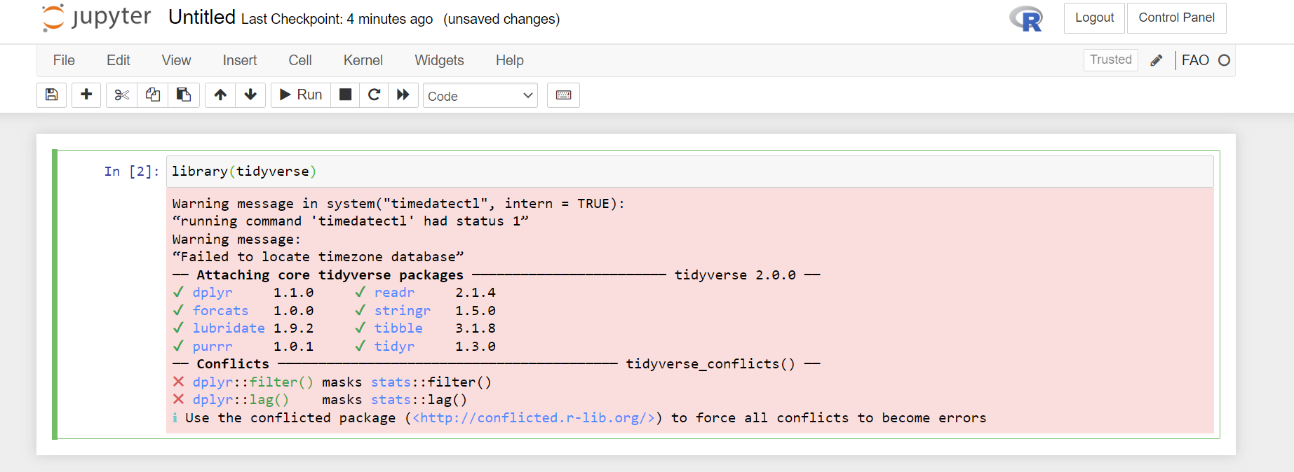
Opening a FAO notebook
Now you can work as you would normally do in Rstudio

Slide 13
Installing packages
Let’s imagine you need a library that it is not installed in FAO or climate4R environments. To install a new package, you need to open a terminal
To install a new package open a terminal

Slide 14
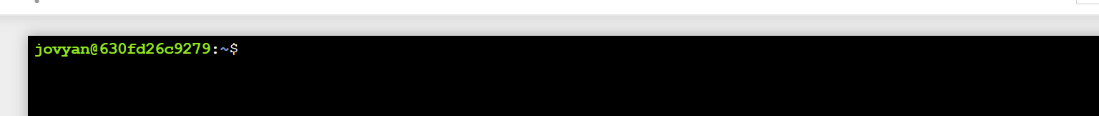
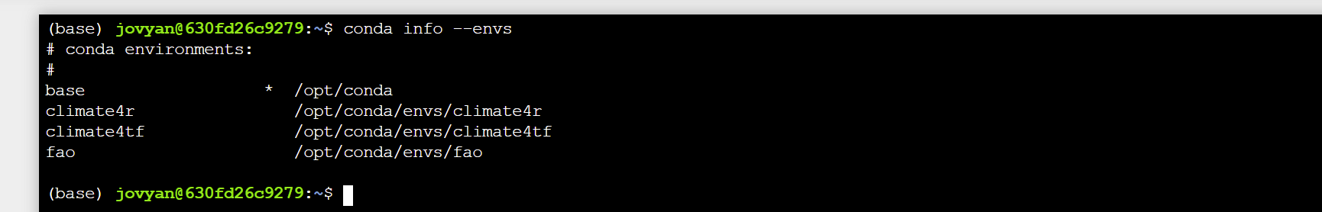
Installing packages
You will now see this
Run conda init bash, close the terminal and open it again
Check the available envs with conda info --envs

Slide 15
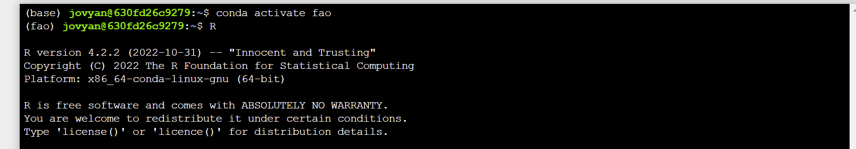
Installing packages
Now activate the environment in which you want to install a package, for example conda activate fao
Open R
Install the required package with install.packages(“ggplot2”)

Slide 16
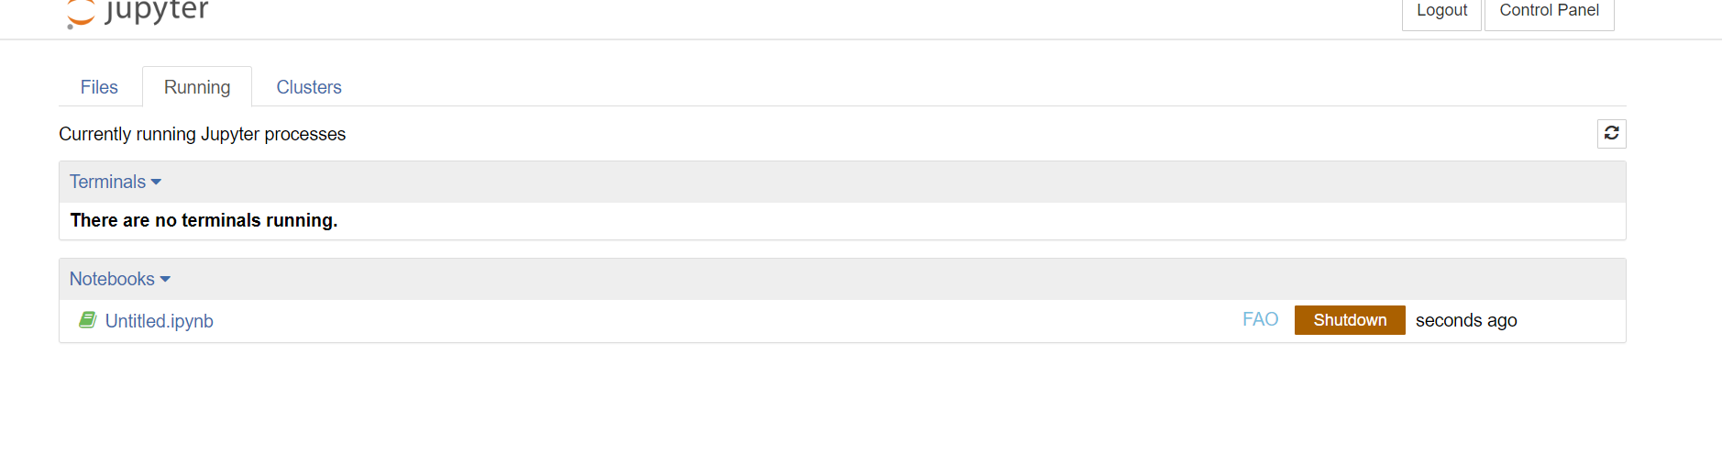
Code of conduct
In the tab running, you will see what is currently running. Remember to click on shutdown when done with your work. If you don’t, you will be occupying memory

Slide 17
Code of conduct
Be mindful on the usage of computational resources as these are shared among several users
Do not upload excessive amount of data (several Gbs) from your local computer
Always close your notebooks when done with your analyses

Slide 18
Exercise (10 minutes)
Create a new folder with your name
Open a FAO notebook and rename it
Close the notebook

Slide 19
Thank you! Contact details: riccardo.soldan@fao.org

